Slide 1
VISION VERSE
Dynamic video question answering VIA
Retrieval-Augmented Generation
Presented By,
Abhiram S Sajeev (MAC20CD003)
Adhya Sanil Joseph (MAC20CD005)
Amal Madhav T (MAC20CD009)
Guided By,
Dr. Surekha Mariam Varghese
09-04-2024 Department of Computer Science & Engineering, M.A.C.E 01

Slide 2
Contents
Vision Verse : Dynamic video question answering through RAG
Introduction
Problem Statement
Literature Survey
Proposed Method
Methodology
Result
Implementation status
Conclusion
References
Paper publication status
09-05-2024 Department of Computer Science & Engineering, M.A.C.E 02
09-04-2024 Department of Computer Science & Engineering, M.A.C.E 02

Slide 3
Introduction
Problem Statement
Literature Survey
Proposed Method
Methodology
Implementation status
Result
Performance Analysis
Conclusion
References
Vision Verse : Dynamic video question answering through RAG
Introduction
Content in the form of video
Length of video
Noise in the video
Click-bait titles
09-05-2024 Department of Computer Science & Engineering, M.A.C.E 03
09-04-2024 Department of Computer Science & Engineering, M.A.C.E 03

Slide 4
Introduction
Problem Statement
Literature Survey
Proposed Method
Methodology
Implementation status
Result
Performance Analysis
Conclusion
References
Vision Verse : Dynamic video question answering through RAG
Problem Statement
To create a chatbot using RA-LLM & Vector-database for brief Q&A session, which sources context from videos
09-05-2024 Department of Computer Science & Engineering, M.A.C.E 04
09-04-2024 Department of Computer Science & Engineering, M.A.C.E 04

Slide 5
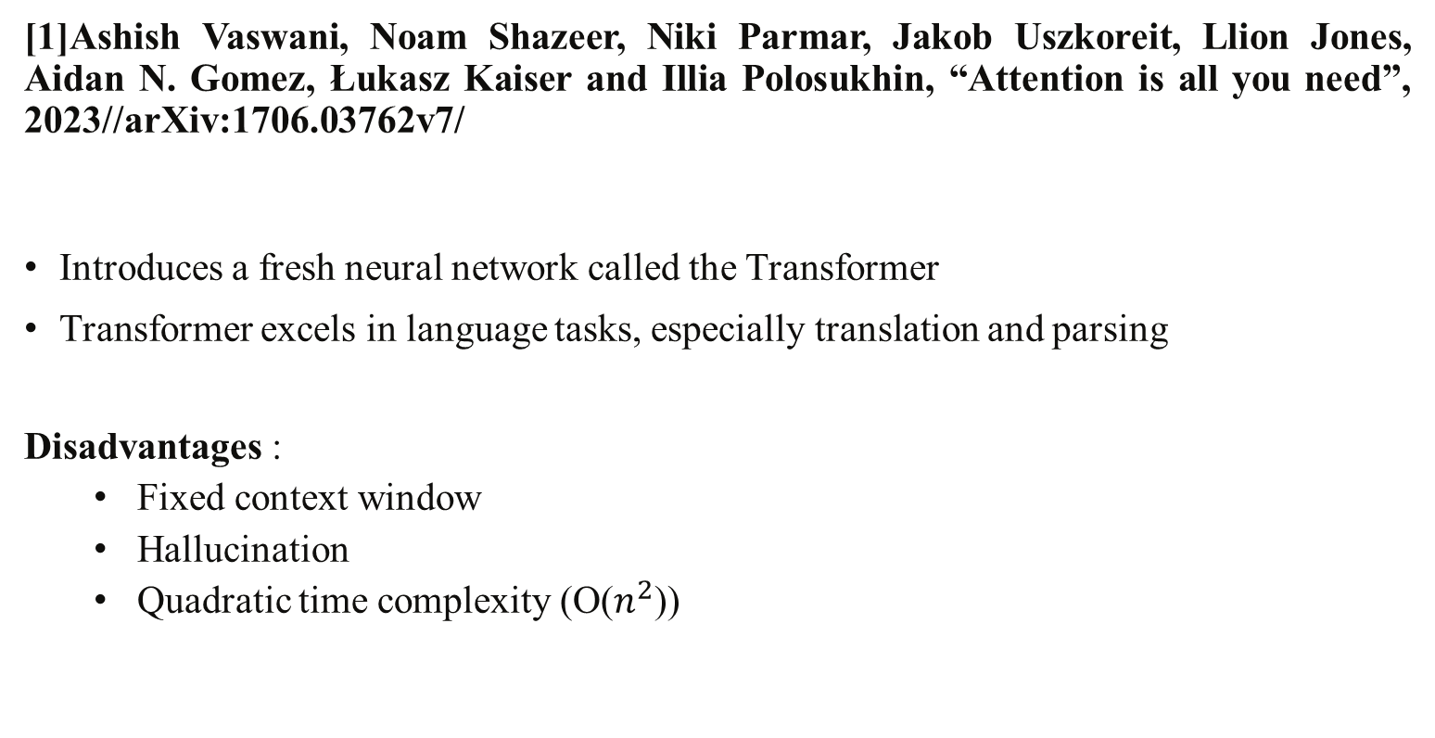
Introduction
Problem Statement
Literature Survey
Proposed Method
Methodology
Implementation status
Result
Performance Analysis
Conclusion
References
Vision Verse : Dynamic video question answering through RAG
Literature Survey
[1]Ashish Vaswani, Noam Shazeer, Niki Parmar, Jakob Uszkoreit, Llion Jones, Aidan N. Gomez, Łukasz Kaiser and Illia Polosukhin, “Attention is all you need”, 2023//arXiv:1706.03762v7/
Introduces a fresh neural network called the Transformer
Transformer excels in language tasks, especially translation and parsing
Disadvantages :
Fixed context window
Hallucination
Quadratic time complexity (O($n^{2}$))
09-05-2024 Department of Computer Science & Engineering, M.A.C.E 05
09-04-2024 Department of Computer Science & Engineering, M.A.C.E 05

Slide 6
Introduction
Problem Statement
Literature Survey
Proposed Method
Methodology
Implementation status
Result
Performance Analysis
Conclusion
References
Vision Verse : Dynamic video question answering through RAG
Literature Survey
[2]Lewis, P. Perez, E. Piktus, A. Petroni, F. Karpukhin, V. Goyal, N. Küttler, H. Lewis, M. Yih, W., T. Rocktäschel, T. Riedel, S., & Kiela, D. (2020, May 22). Retrieval-Augmented Generation for Knowledge-Intensive NLP Tasks//arxiv:2005.11401
Model which combine pre-trained parametric and non-parametric memory for language generation
Open-domain Question Answering
Long-term memory for LLMs
09-05-2024 Department of Computer Science & Engineering, M.A.C.E 06
09-04-2024 Department of Computer Science & Engineering, M.A.C.E 06

Slide 7
Introduction
Problem Statement
Literature Survey
Proposed Method
Methodology
Implementation status
Result
Performance Analysis
Conclusion
References
Vision Verse : Dynamic video question answering through RAG
Literature Survey
[3]Jon Saad-Falcon, Joe Barrow, Alexa Siu, Ani Nenkova, David Seunghyun Yoon, Ryan A. Rossi & Franck Dernoncourt “PDFTriage: Question Answering over Long Structured Documents”, 2023//arXiv:2309.08872v2/
Advantages:
Method to improve LLM for question answering in structured documents
Introduced chaining method for answering over large context
Enhances context retrieval by considering document structure and content
Disadvantages:
Large latency for answering
Heavy on computation
09-05-2024 Department of Computer Science & Engineering, M.A.C.E 07
09-04-2024 Department of Computer Science & Engineering, M.A.C.E 07

Slide 8
Introduction
Problem Statement
Literature Survey
Proposed Method
Methodology
Implementation status
Result
Performance Analysis
Conclusion
References
Vision Verse : Dynamic video question answering through RAG
Literature Survey
[4]Radford, A. (2022, December 6). “Robust Speech Recognition via Large-Scale Weak Supervision”//arxiv:2212.04356
Advantages:
Model perform well in zero-shot transfer settings
Accuracy and robustness of human performance
Attention mechanism
Disadvantages:
Provide best performance in English only
09-05-2024 Department of Computer Science & Engineering, M.A.C.E 08
09-04-2024 Department of Computer Science & Engineering, M.A.C.E 08

Slide 9
Introduction
Problem Statement
Literature Survey
Proposed Method
Methodology
Implementation status
Result
Performance Analysis
Conclusion
References
Vision Verse : Dynamic video question answering through RAG
Literature Survey
[5] Yu. A. Malkov and D. A. Yashunin. (2016, March 30). “Efficient and robust approximate nearest neighbor search using Hierarchical Navigable Small World graphs”//arxiv:1603.09320
Advantages:
Approximate K-nearest neighbor search based on navigable small world graphs
Fully graph-based, without any need for additional search structures
Highly scalable
Outperform previous opensource state-of-the-art vector-only approaches.
09-05-2024 Department of Computer Science & Engineering, M.A.C.E 09
09-04-2024 Department of Computer Science & Engineering, M.A.C.E 08

Slide 10
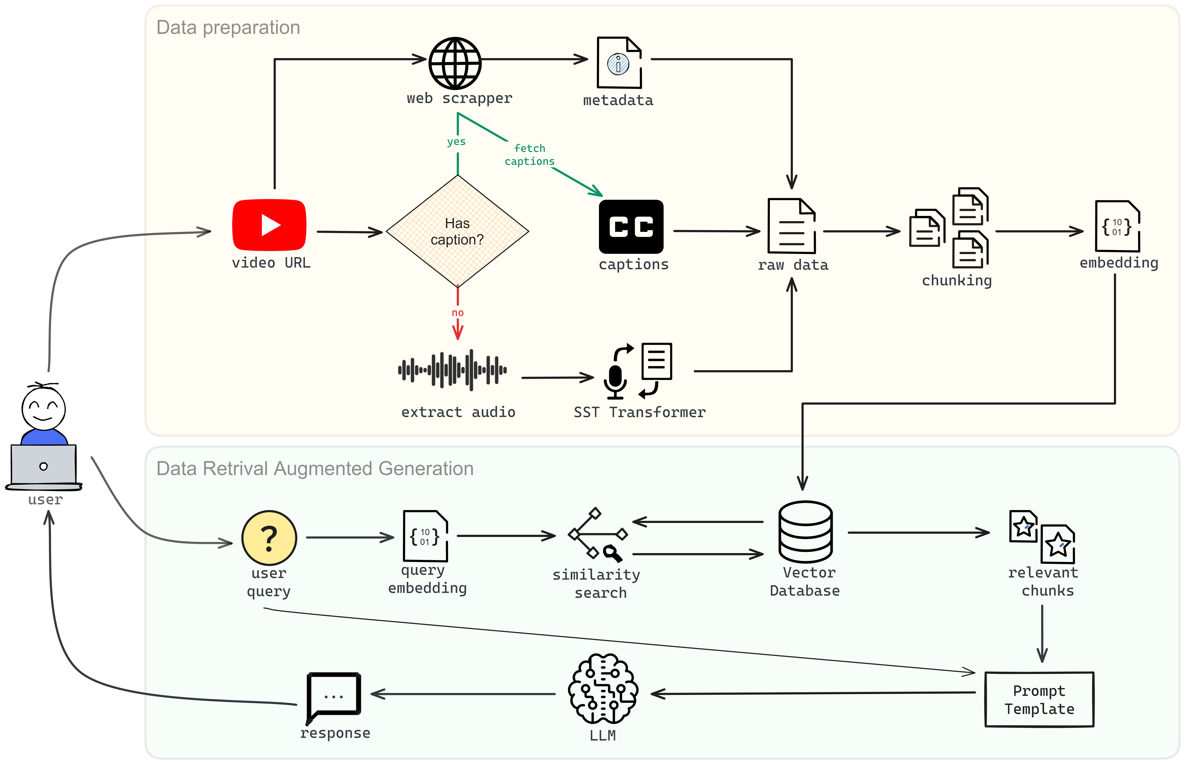
Architecture
Introduction
Problem Statement
Literature Survey
Proposed Method
Methodology
Implementation status
Result
Performance Analysis
Conclusion
References
Proposed Method
Fig 1 : Architecture
09-05-2024 Department of Computer Science & Engineering, M.A.C.E 10
09-04-2024 Department of Computer Science & Engineering, M.A.C.E 09
Notes:
2 phase architecture data preaparation where we collect the required video context using different methodolodyies and do some data per processing for improving the effeccy of the system and store it in the data bae data retivela and augemented generation where when the user ask a query the system geneate answers based on context prepared easrt

Slide 11
Introduction
Problem Statement
Literature Survey
Proposed Method
Methodology
Implementation status
Result
Performance Analysis
Conclusion
References
Vision Verse : Dynamic video question answering through RAG
Data Preparation
2 types of data required for reliable generation
1. Metadata
Mining the required data from provided URL
Title
Description
Uploader
Date of upload, etc.
2. Video Transcript
Prepared in two ways
a. Captions(if available)
b. Speech to text transformer
Methodology
09-05-2024 Department of Computer Science & Engineering, M.A.C.E 11
09-04-2024 Department of Computer Science & Engineering, M.A.C.E 13
Notes:
Data extracted from source the an

Slide 12

Introduction
Problem Statement
Literature Survey
Proposed Method
Methodology
Implementation status
Result
Performance Analysis
Conclusion
References
Vision Verse : Dynamic video question answering through RAG
Speech to text transformer
Model : whisper-small-244M
Transformer based model
Self-Attention mechanism
Accuracy
Methodology
Fig 1.2
09-05-2024 Department of Computer Science & Engineering, M.A.C.E 12
09-04-2024 Department of Computer Science & Engineering, M.A.C.E 13
Notes:
The self-attention mechanism in transformers also enables the model to consider the entire data sequence simultaneously.

Slide 13
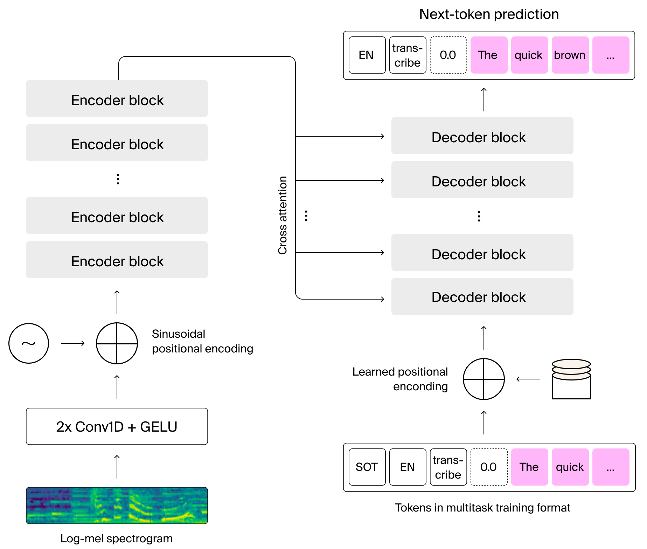
Introduction
Problem Statement
Literature Survey
Proposed Method
Methodology
Implementation status
Result
Performance Analysis
Conclusion
References
Vision Verse : Dynamic video question answering through RAG
Methodology
Fig 2 : Whisper Architecture
09-05-2024 Department of Computer Science & Engineering, M.A.C.E 13
09-04-2024 Department of Computer Science & Engineering, M.A.C.E 13
Notes:
The self-attention mechanism in transformers also enables the model to consider the entire data sequence simultaneously.
Cross attention allows to inegrate what is being generated so far and all the data in the encoder block

Slide 14


Introduction
Problem Statement
Literature Survey
Proposed Method
Methodology
Implementation status
Result
Performance Analysis
Conclusion
References
Vision Verse : Dynamic video question answering through RAG
Data Processing (conti.)
Chunking
Need for chunking
Recursive character text splitter
Overlapping chunks
Embedding
Need for embedding
Preserve semantic meaning
Embedding scheme : voyage-larger-2
Methodology
Fig 1.2
Fig 1.3
09-05-2024 Department of Computer Science & Engineering, M.A.C.E 14
09-04-2024 Department of Computer Science & Engineering, M.A.C.E 13
Notes:
So far we got the metadta and transcript in a file
Then we will slice this huge corpus of data to chunk slices

Slide 15
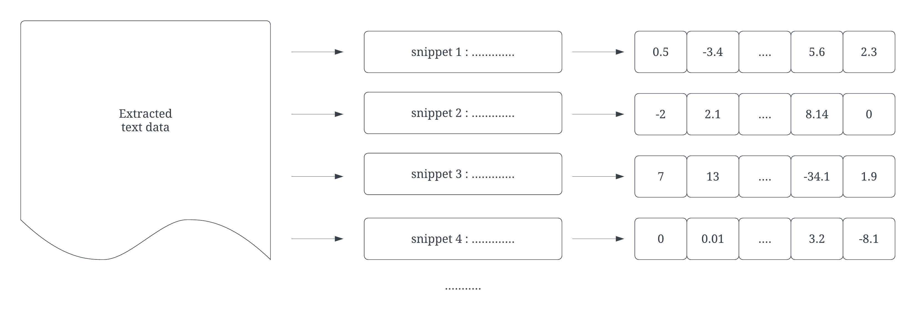


Chunking and Embedding
Introduction
Problem Statement
Literature Survey
Proposed Method
Methodology
Implementation status
Result
Performance Analysis
Conclusion
References
Vision Verse : Dynamic video question answering through RAG
Methodology
Raw data (text corpus)
Fig 4 : Pre-Processing the text data
09-05-2024 Department of Computer Science & Engineering, M.A.C.E 15
09-04-2024 Department of Computer Science & Engineering, M.A.C.E 15

Slide 16
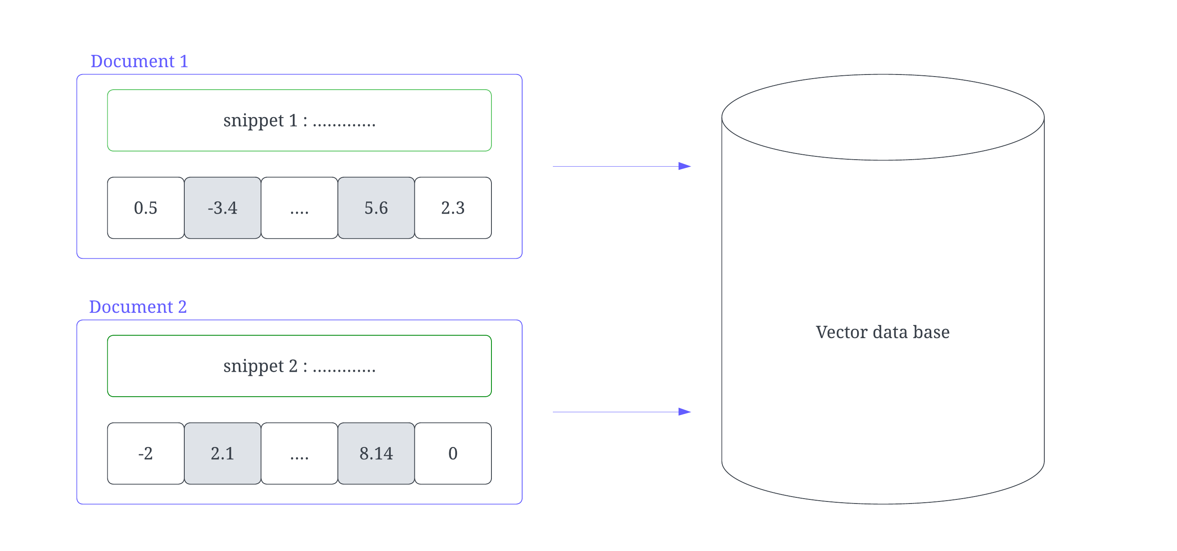
Store vectors & snippets in a VectorDB
Introduction
Problem Statement
Literature Survey
Proposed Method
Methodology
Implementation status
Result
Performance Analysis
Conclusion
References
Vision Verse : Dynamic video question answering through RAG
Methodology
Vector
Database
Fig 5 : Store embedded vectors in VectorDB
09-05-2024 Department of Computer Science & Engineering, M.A.C.E 16
09-04-2024 Department of Computer Science & Engineering, M.A.C.E 16

Slide 17
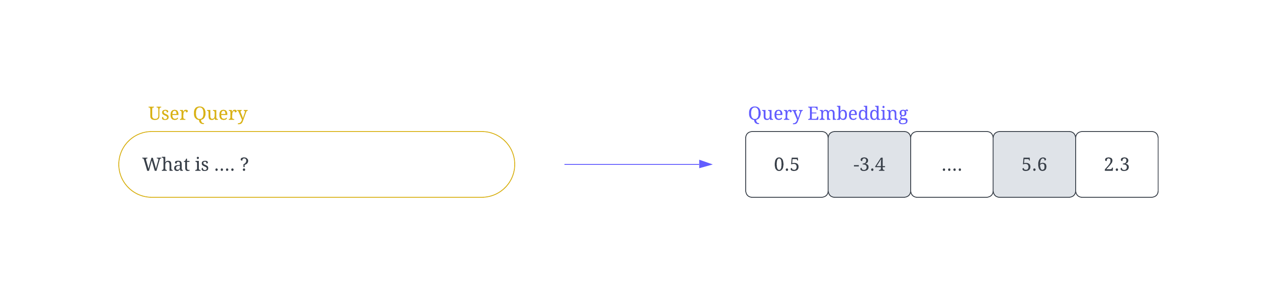
Introduction
Problem Statement
Literature Survey
Proposed Method
Methodology
Implementation status
Result
Performance Analysis
Conclusion
References
Vision Verse : Dynamic video question answering through RAG
Data Retrieval Augmented Generation
User query and embedding
Similarity search in Vector DB
Methodology
Fig 6 : Converting user query to an embedding
09-05-2024 Department of Computer Science & Engineering, M.A.C.E 17
09-04-2024 Department of Computer Science & Engineering, M.A.C.E 17

Slide 18
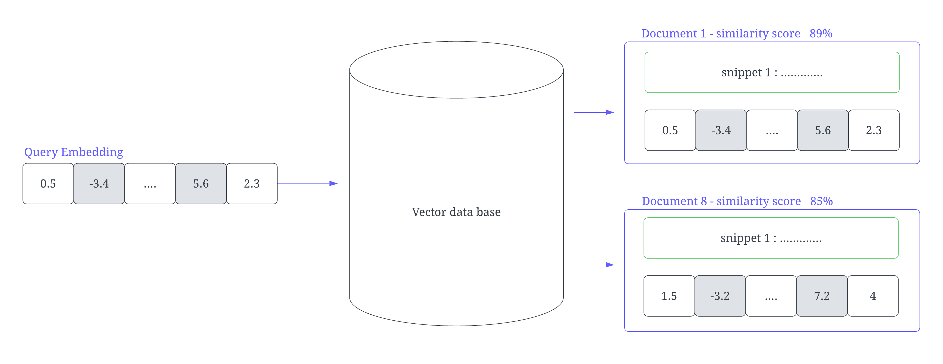
Data Retrieval Augmented Generation (Contd.)
Introduction
Problem Statement
Literature Survey
Proposed Method
Methodology
Implementation status
Result
Performance Analysis
Conclusion
References
Vision Verse : Dynamic video question answering through RAG
Methodology
Vector Database
Fig 7 : Perform similarity search in VBD and retrieve relevant information
09-05-2024 Department of Computer Science & Engineering, M.A.C.E 18
09-04-2024 Department of Computer Science & Engineering, M.A.C.E 18

Slide 19
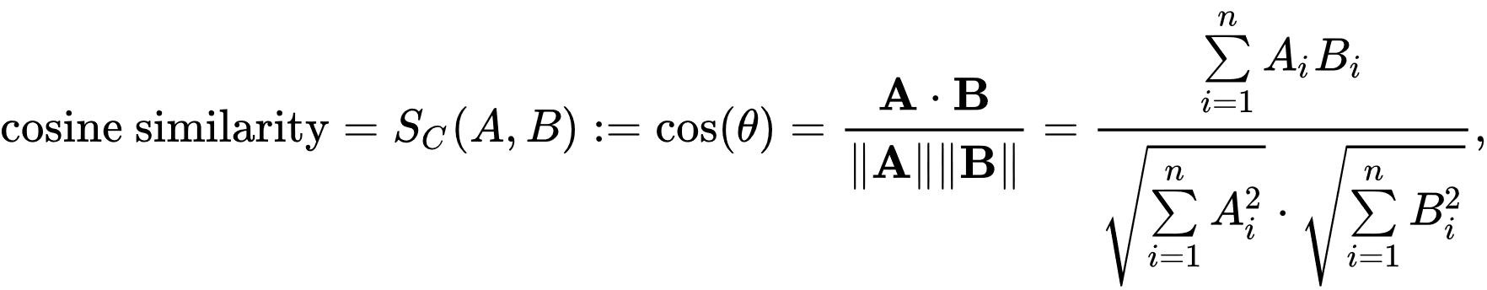
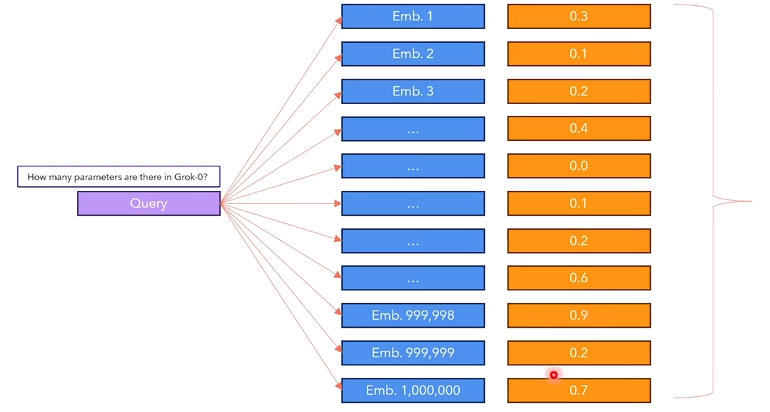
Data Retrieval Augmented Generation (Contd.)
Introduction
Problem Statement
Literature Survey
Proposed Method
Methodology
Implementation status
Result
Performance Analysis
Conclusion
References
Vision Verse : Dynamic video question answering through RAG
How to find the relevant chunks?
Similarity score calculation : Cosine similarity
Search Time complexity O(N*D)
Methodology
vector
Sim. score
Keep Top-k
Fig 8 : similarity search
09-05-2024 Department of Computer Science & Engineering, M.A.C.E 19
09-04-2024 Department of Computer Science & Engineering, M.A.C.E 19

Slide 20
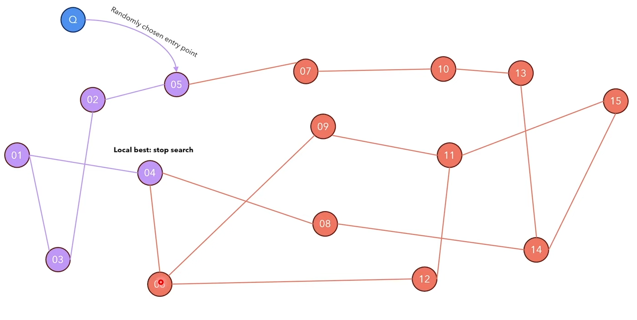
Data Retrieval Augmented Generation (Contd.)
Introduction
Problem Statement
Literature Survey
Proposed Method
Methodology
Implementation status
Result
Performance Analysis
Conclusion
References
Vision Verse : Dynamic video question answering through RAG
Faster search : HNSW algorithm
Methodology
Fig 8 : Visualization of NSW
09-05-2024 Department of Computer Science & Engineering, M.A.C.E 20
09-04-2024 Department of Computer Science & Engineering, M.A.C.E 19

Slide 21
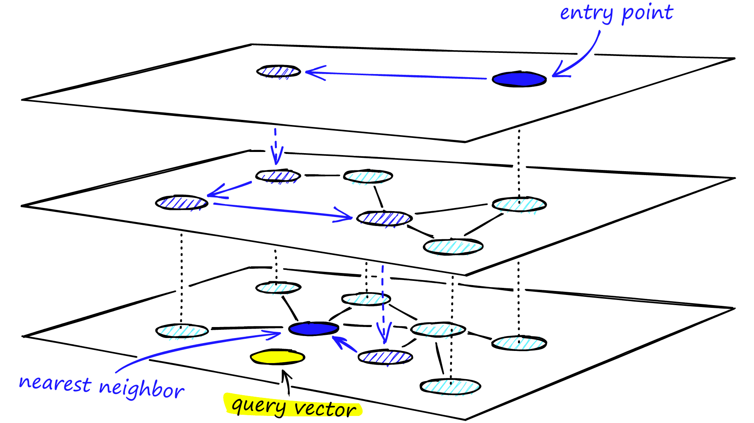
Data Retrieval Augmented Generation (Contd.)
Introduction
Problem Statement
Literature Survey
Proposed Method
Methodology
Implementation status
Result
Performance Analysis
Conclusion
References
Vision Verse : Dynamic video question answering through RAG
Faster search : HNSW algorithm
K - Nearest Neighbour to query
Skip-list
Time complexity – O(log(n))
Methodology
Fig 8 : Visualization of HSNW
09-05-2024 Department of Computer Science & Engineering, M.A.C.E 20
09-04-2024 Department of Computer Science & Engineering, M.A.C.E 19

Slide 22
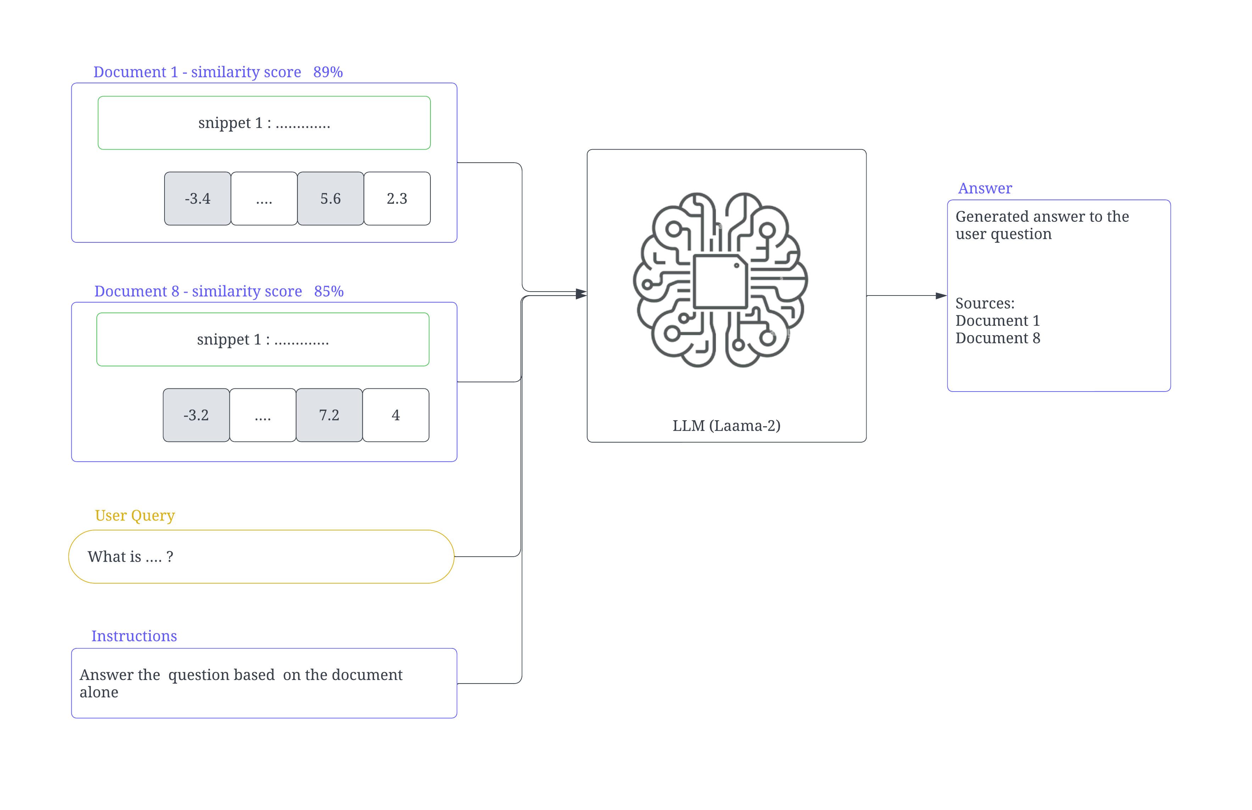
Data Retrieval Augmented Generation (Contd.)
Introduction
Problem Statement
Literature Survey
Proposed Method
Methodology
Implementation status
Result
Performance Analysis
Conclusion
References
Vision Verse : Dynamic video question answering through RAG
Methodology
Fig 9 : Ask LLM to answer query based on relevant documents
09-05-2024 Department of Computer Science & Engineering, M.A.C.E 21
09-04-2024 Department of Computer Science & Engineering, M.A.C.E 20

Slide 23
Data Retrieval Augmented Generation (Contd.)
Introduction
Problem Statement
Literature Survey
Proposed Method
Methodology
Implementation status
Result
Performance Analysis
Conclusion
References
Vision Verse : Dynamic video question answering through RAG
Prompt template
User Query
Source of answers
System prompt of Llama 2
Temperature of generation
Reliability and accuracy
Methodology
09-05-2024 Department of Computer Science & Engineering, M.A.C.E 22
09-04-2024 Department of Computer Science & Engineering, M.A.C.E 21

Slide 24
Software Requirements
Introduction
Problem Statement
Literature Survey
Proposed Method
Methodology
Performance Evaluation
Result
Performance Analysis
Conclusion
References
Vision Verse : Dynamic video question answering through RAG
python3
Langchain Framework
Whisper audio to text
pytube
FIASS Vector DB
LLM (open access model – Llama 2)
Javascript
Streamlit
Implementation status
09-05-2024 Department of Computer Science & Engineering, M.A.C.E 23
09-04-2024 Department of Computer Science & Engineering, M.A.C.E 22

Slide 25
Introduction
Problem Statement
Literature Survey
Proposed Method
Methodology
Performance Evaluation
Result
Performance Analysis
Conclusion
References
Vision Verse : Dynamic video question answering through RAG
Improved the performance of Audio to Text Conversion throughput by 6x
Implemented transformer bases SST
Old TTS engine took 6 minutes
Same task, new optimized method took only 53 seconds
Implemented Caption-scraping to improve the context fetching time
Some videos contain captions provided by the Creator
In such cases we can directly fetch the context
Thereby omitting the intensive STT process
Implementation status
09-05-2024 Department of Computer Science & Engineering, M.A.C.E 24
09-04-2024 Department of Computer Science & Engineering, M.A.C.E 23

Slide 26
Introduction
Problem Statement
Literature Survey
Proposed Method
Methodology
Performance Evaluation
Result
Performance Analysis
Conclusion
References
Vision Verse : Dynamic video question answering through RAG
HNSW vs other algorithm to find nearest neigbour
KNN – O(nd)
NSW - O(logᵏ(n))
HNSW – O(log(n))
Significantly reduced the computation with scale
Implementation status
09-05-2024 Department of Computer Science & Engineering, M.A.C.E 25
09-04-2024 Department of Computer Science & Engineering, M.A.C.E 23

Slide 27
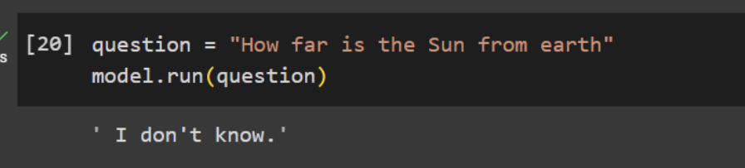
Introduction
Problem Statement
Literature Survey
Proposed Method
Methodology
Performance Evaluation
Result
Performance Analysis
Conclusion
References
Vision Verse : Dynamic video question answering through RAG
Verified Retrieval for Reliable Generation
LLM hallucination problem
No relevant context -> “I don’t know”
Context : Video of Elon musk advise to young people.
Implementation status
Fig 10 : Handling out of context questions
09-05-2024 Department of Computer Science & Engineering, M.A.C.E 26
09-04-2024 Department of Computer Science & Engineering, M.A.C.E 24

Slide 28
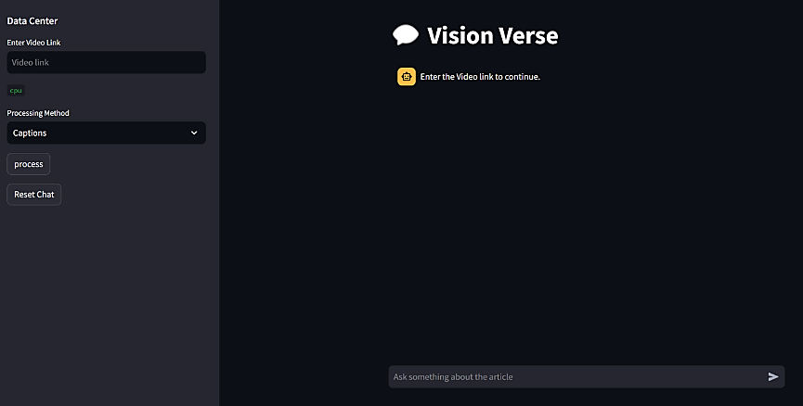
Frontend of chat interface
Introduction
Problem Statement
Literature Survey
Proposed Method
Methodology
Implementation status
Result
Performance Analysis
Conclusion
References
Vision Verse : Dynamic video question answering through RAG
Result
Fig 11 : Frontend implementation in python and streamlit
09-05-2024 Department of Computer Science & Engineering, M.A.C.E 27
09-04-2024 Department of Computer Science & Engineering, M.A.C.E 25

Slide 29
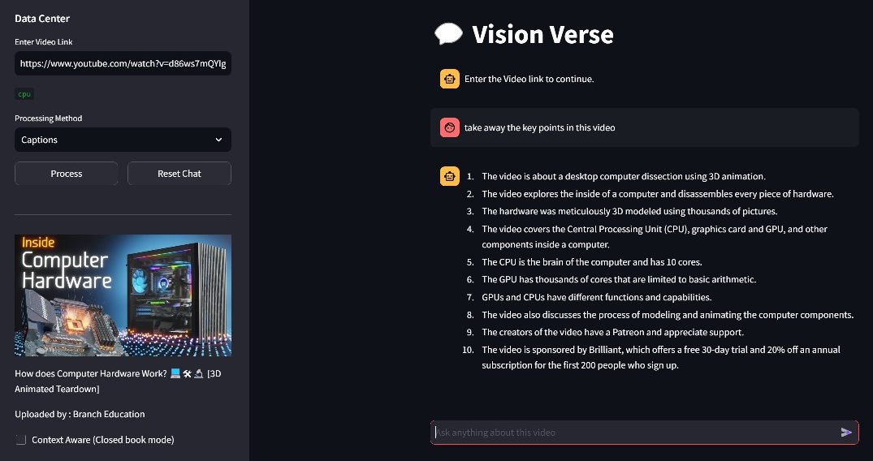
Introduction
Problem Statement
Literature Survey
Proposed Method
Methodology
Implementation status
Result
Performance Analysis
Conclusion
References
Vision Verse : Dynamic video question answering through RAG
Result
Fig 12 : Answer to user query
09-05-2024 Department of Computer Science & Engineering, M.A.C.E 28
09-04-2024 Department of Computer Science & Engineering, M.A.C.E 26

Slide 30
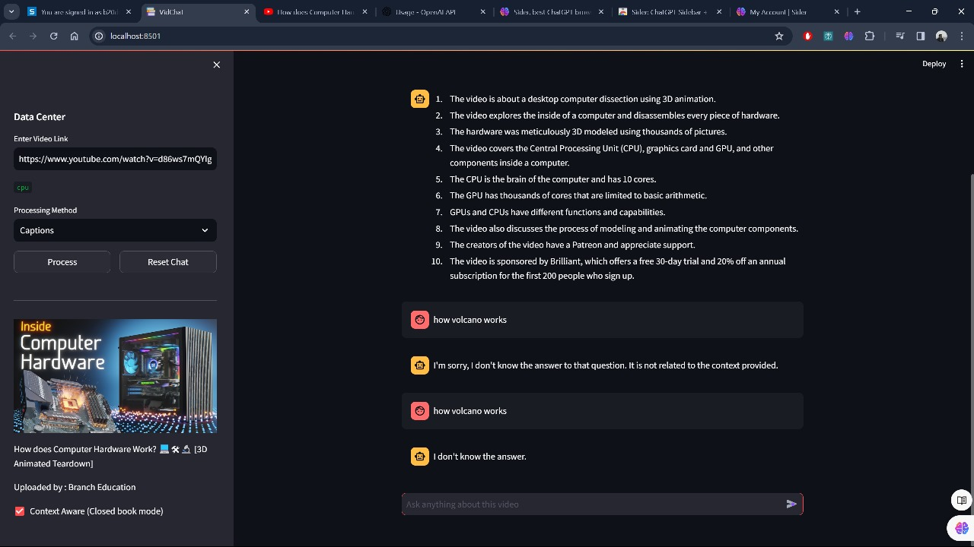
Introduction
Problem Statement
Literature Survey
Proposed Method
Methodology
Implementation status
Result
Performance Analysis
Conclusion
References
Vision Verse : Dynamic video question answering through RAG
Result
Fig 13 : Response to out of context question with respect to video
09-05-2024 Department of Computer Science & Engineering, M.A.C.E 29
09-04-2024 Department of Computer Science & Engineering, M.A.C.E 27

Slide 31
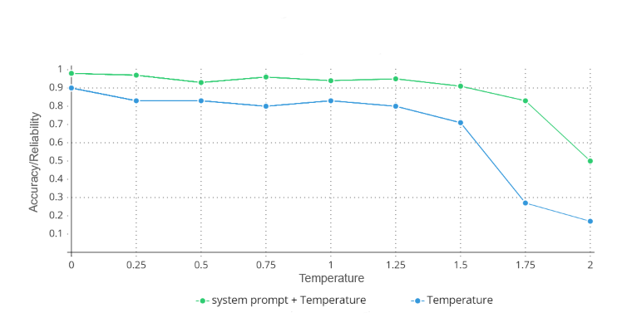
Introduction
Problem Statement
Literature Survey
Proposed Method
Methodology
Implementation status
Result
Performance Analysis
Conclusion
References
Vision Verse : Dynamic video question answering through RAG
Reliability : Rejection of out of context questions
Performance Analysis
Fig 14 : Reliability graph on sample of 100 query per temperature value
09-05-2024 Department of Computer Science & Engineering, M.A.C.E 30
09-04-2024 Department of Computer Science & Engineering, M.A.C.E 28

Slide 32
Introduction
Problem Statement
Literature Survey
Proposed Method
Methodology
Implementation status
Result
Performance Analysis
Conclusion
References
Vision Verse : Dynamic video question answering through RAG
Reliability of response w.r.t different parameters
System Prompt
Craft to handle hallucination
Open book exam mode
Temperature
Vary between [0, 2]
Creativity of generation mode
Temperature selection
Quality of the retriever
Retriever must be able to identify the relevant chunks that can best answer the user's query.
Generator’s response is based on the information provided by the retriever
Performance Analysis
09-05-2024 Department of Computer Science & Engineering, M.A.C.E 31
09-04-2024 Department of Computer Science & Engineering, M.A.C.E 29

Slide 33
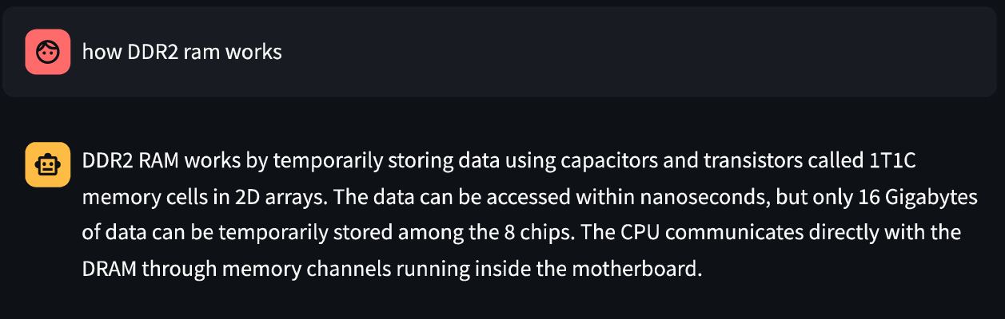
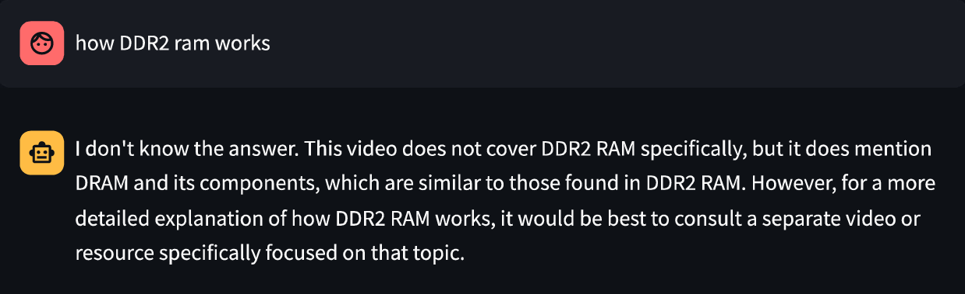
Introduction
Problem Statement
Literature Survey
Proposed Method
Methodology
Implementation status
Result
Performance Analysis
Conclusion
References
Vision Verse : Dynamic video question answering through RAG
Fig 14 : Hallucinated response, when the question aligns closely the context (Temp =1.5)
Performance Analysis
Fig 15 : Highly reliable response, when the question aligns closely the context (Temp =0.1)
09-05-2024 Department of Computer Science & Engineering, M.A.C.E 32
09-04-2024 Department of Computer Science & Engineering, M.A.C.E 30

Slide 34
Introduction
Problem Statement
Literature Survey
Proposed Method
Methodology
Implementation status
Result
Performance Analysis
Conclusion
References
Vision Verse : Dynamic video question answering through RAG
Saves time, improves engagement
Project tackles video information overload
Offers concise answers
Multilingual Support
Educational learning aid
Conclusion
09-05-2024 Department of Computer Science & Engineering, M.A.C.E 33
09-04-2024 Department of Computer Science & Engineering, M.A.C.E 31

Slide 35
Introduction
Problem Statement
Literature Survey
Proposed Method
Methodology
Implementation status
Result
Performance Analysis
Conclusion
References
Vision Verse : Dynamic video question answering through RAG
[1]Ashish Vaswani, Noam Shazeer, Niki Parmar, Jakob Uszkoreit, Llion Jones, Aidan N. Gomez, Łukasz Kaiser and Illia Polosukhin “Attention is all you need”, 2023//arXiv:1706.03762v7/
[2]Jon Saad-Falcon, Joe Barrow, Alexa Siu , Ani Nenkova, David Seunghyun Yoon, Ryan A. Rossi and Franck Dernoncourt “PDFTriage: Question Answering over Long, Structured Documents”, 2023//arXiv:2309.08872v2/
[3]Md Adnan Arefeen, Biplob Debnath1, and Srimat Chakradhar “LeanContext: Cost-Efficient Domain-Specific Question Answering Using LLMs”, 2023//arXiv:2309.00841v1
References
09-05-2024 Department of Computer Science & Engineering, M.A.C.E 34
09-04-2024 Department of Computer Science & Engineering, M.A.C.E 32

Slide 36
Introduction
Problem Statement
Literature Survey
Proposed Method
Methodology
Implementation status
Result
Performance Analysis
Conclusion
References
Vision Verse : Dynamic video question answering through RAG
[4]Radford, A. (2022, December 6). Robust Speech Recognition via Large-Scale Weak Supervision//arxiv:/2212.04356
[5]Dr. M. Saraswathi, VVSV Ronit and S Sai Pranav "Implementation of Video and Audio to Text Converter", 2023//International Journal of Research Publication and Reviews, Vol 4, no 5, pp 1204-1208, ISSN 2582-7421/
[6]Zhongqiang Huang and Mary Harper. Self-training PCFG grammars with latent annotations across languages. In Proceedings of the 2009 Conference on Empirical Methods in Natural Language Processing, pages 832–841. ACL, August 2009/
References
09-05-2024 Department of Computer Science & Engineering, M.A.C.E 35
09-04-2024 Department of Computer Science & Engineering, M.A.C.E 33

Slide 37
Introduction
Problem Statement
Literature Survey
Proposed Method
Methodology
Implementation status
Result
Performance Analysis
Conclusion
References
Vision Verse : Dynamic video question answering through RAG
[7]https://www.youtube.com/watch?v=bCz4OMemCcA
[8]https://www.youtube.com/watch?v=TQQlZhbC5ps
[9]David McClosky, Eugene Charniak, and Mark Johnson. Effective self-training for parsing. In Proceedings of the Human Language Technology Conference of the NAACL, Main Conference, pages 152–159. ACL, June 2006/
References
09-05-2024 Department of Computer Science & Engineering, M.A.C.E 36
09-04-2024 Department of Computer Science & Engineering, M.A.C.E 34

Slide 38
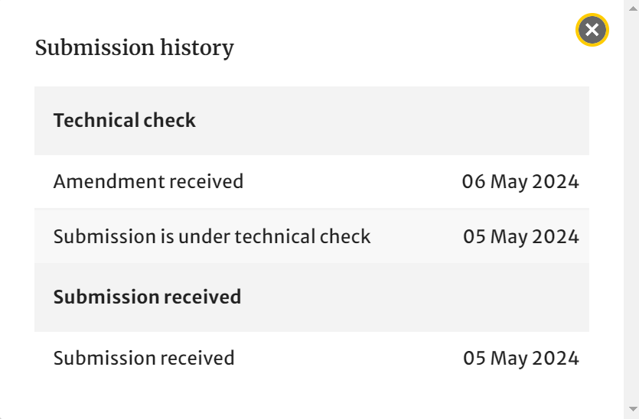
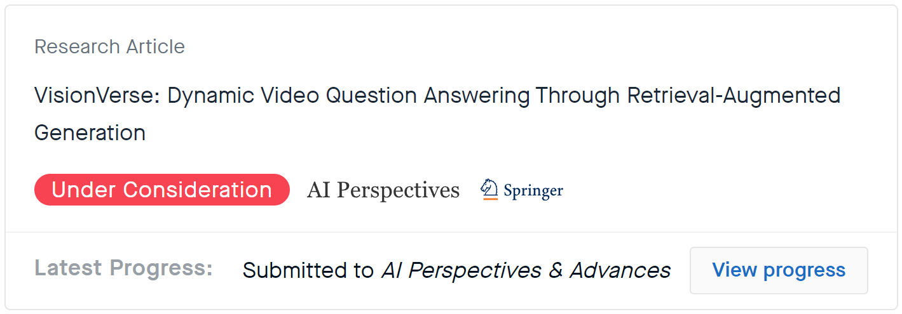
Introduction
Problem Statement
Literature Survey
Proposed Method
Methodology
Implementation status
Result
Performance Analysis
Conclusion
References
Vision Verse : Dynamic video question answering through RAG
Published in : Springer
Journal : AI Perspectives & Advances
Received 1st technical check review : suggested for amendment
Implemented the suggestions and send for 2nd review
Fig 15 : Research Square pre-print status
Paper publication
Fig 16 : Springer Status
09-05-2024 Department of Computer Science & Engineering, M.A.C.E 37
09-04-2024 Department of Computer Science & Engineering, M.A.C.E 34

